Slide 1

Heart Failure Predictions Based on Patients’ Health Attributes
Adil Khan
Bellevue University

Slide 2
Intro/Background of the Problem
Cardiovascular disease is a general term used for any disease associated with the heart and its blood vessels. A few common cardiovascular diseases include heart failure, heart attack, stroke, and sudden cardiac arrest. Heart failure occurs when the heart cannot pump enough blood to meet the body’s demand. Given the importance of a vital organ such as the heart, predicting Bellevue University Page | 3 heart failure has become a priority for health care professionals (Chicco, 2020).

Slide 3
Ethical Considerations
The leading cause of mortality worldwide, cardiovascular diseases (CVDs), claim 17.9 million lives annually, or 31% of all fatalities worldwide. The majority of cardiovascular illnesses may be avoided by employing population-wide measures to target behavioural risk factors such cigarette use, poor eating and obesity, inactivity, and problematic alcohol consumption.
Notes:
Early detection and management of people with cardiovascular disease or who are at high cardiovascular risk (due to the presence of one or more risk factors like hypertension, diabetes, hyperlipidemia, or already established disease) are essential, and a machine learning model can be very helpful in this regard.

Slide 4

Methodology
The strategy was divided into three stages in order to create a predictive model. The activities that must be completed before moving on to the next step are included in each phase.
• Phase 1 – exploratory data analysis.
• Phase 2 – this is the feature selection phase.
• Phase 3 – The characteristics will be applied to the construction of the prediction models in this step after being chosen. The dataset's existing data will be used to execute and train the model.
Notes:
The strategy was divided into three stages in order to create a predictive model. The activities that must be completed before moving on to the next step are included in each phase.
• Phase 1 – exploratory data analysis. The initial stage in every data science analysis task is this phase. Since there are 13 variables total in the dataset, several of them may or may not be correlated, particularly with the feature in question, the death event variable. We must thus picture and comprehend how they are distributed. We must also make careful to look for outliers and missing numbers.
• Phase 2 – this is the feature selection phase. Once we are aware of how each variable relates to and correlates with our main variable, death event. Then, to base the prediction model on, we may choose the attributes that have the most effect and connection with the primary variable we have chosen. To determine which machine learning model is best for our prediction model, we will test a variety of them. Decision trees, logistic regression, support vector machines, k-nearest neighbours, random forests, and other machine learning models will all be employed in this model.
• Phase 3 – The characteristics will be applied to the construction of the prediction models in this step after being chosen. The dataset's existing data will be used to execute and train the model.

Slide 5
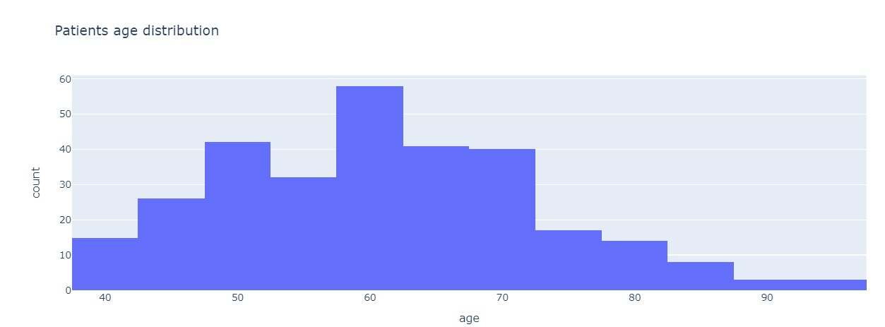
Exploratory Data Analysis (EDA)
Notes:
Figure 1: Patients’ age distribution
According to Figure 1, the majority of patients are in the 50–70 age range, with the bulk of patients being about 60 years old and a minority being at least 90 years old.
In order to observe the link between age and gender in our sample set, we added another variable to the age distribution

Slide 6
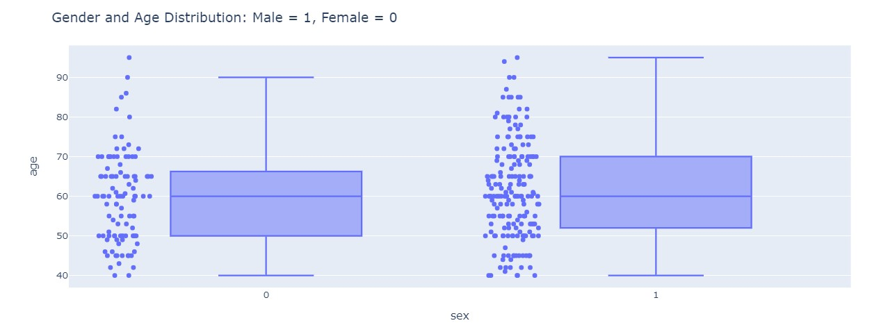
Notes:
The association between age and gender in the sample is depicted as a box-and-whisker plot in Figure 2.
According to Figure 2's gender and age distribution, male patients have a far wider range of ages than female patients. Male age distribution ranges consistently from 40 to 90, while female age distribution is mostly centred in the 40 to 70 age range.

Slide 7
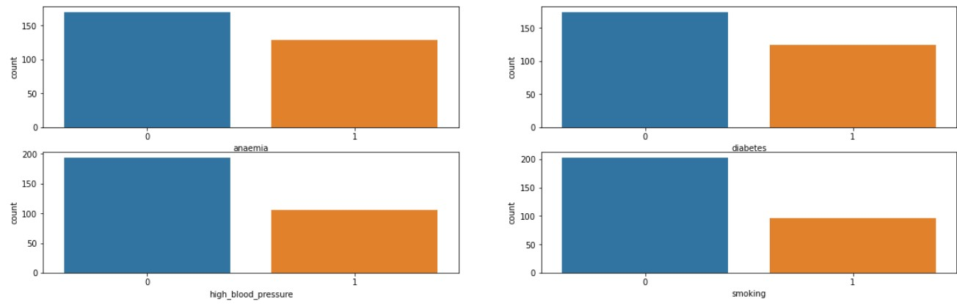
Notes:
Figure 3 shows that around 43% of the sample has anaemia, 41% has diabetes, 35% has high blood pressure, 32% smokes, and some individuals may have several illnesses.

Slide 8
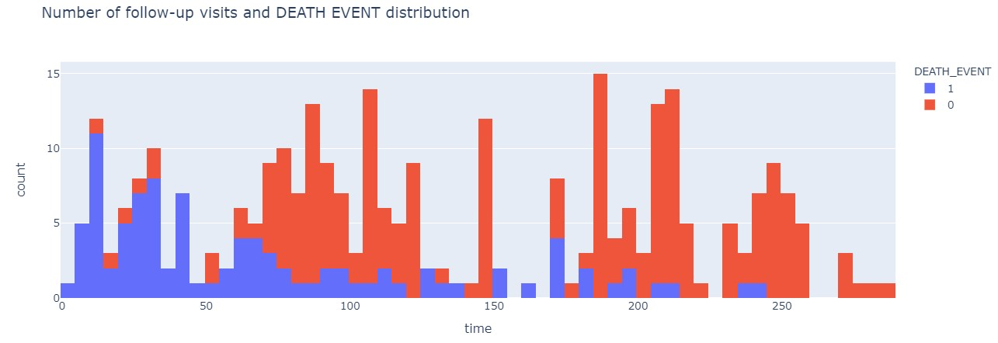
Notes:
As we dug further into the information to examine associations between various variables, we created a histogram to compare the death event vs the quantity of follow-up visits, as seen in Figure .
The likelihood that a patient would survive a heart failing condition or pass away appears to be correlated with the frequency and quantity of follow-up visits. A patient has a greater likelihood of survival the more frequently they attend their scheduled follow-up appointments, and vice versa.

Slide 9
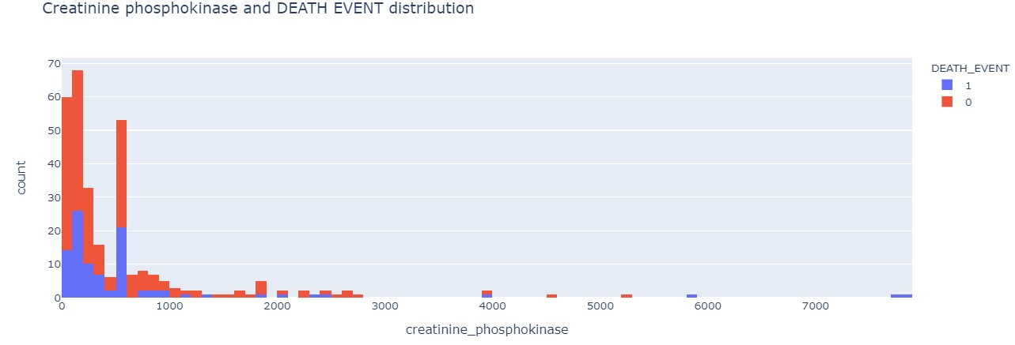
Notes:
Before, it was believed that if a muscle tissue is damaged, creatinine phosphokinase will flow into the blood, which may also be one of the symptoms of heart failure (Stewart, 2020). Therefore, we sought to identify any associations between creatinine phosphokinase and fatal events, as shown in Figure 5.
The distribution pattern for the enzyme creatinine phosphokinase, or CPK, appears to be rather comparable in samples that have survived and those that have not. Although the CPK level had a few outliers, they were small and were ignored in the study.

Slide 10
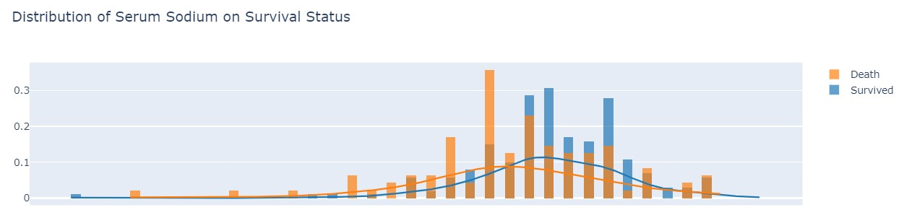
Notes:
If we look at Figure distribution trend for serum sodium on the survival status of either survived or died from heart failure, those who survived heart failure had a little higher distribution curve of serum sodium in their bloodstream than those who did not. Those who lived had a median level of 137 serum sodium in their circulation, compared to 134 for those who did not.

Slide 11
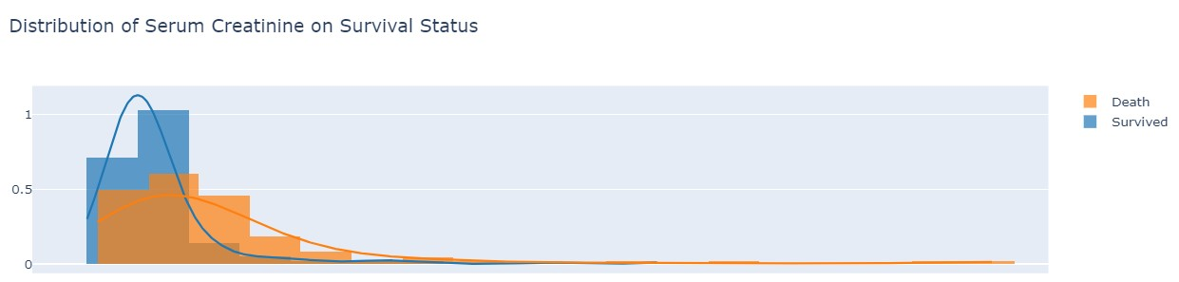
Notes:
According to the pattern seen in Figure 7, individuals who survived with heart failure disease had lower serum creatinine levels than those who did not. For people who survived with heart failure, a median serum creatinine level of 1 is considered normal. On the other hand, individuals who passed away from heart failure had a median serum creatinine level of 1.5. Since serum creatinine is produced as a byproduct of creatinine, renal dysfunction may be to blame for elevated serum creatinine levels (Stephens, 2019). This may help to explain why those who died of heart failure had such elevated serum creatinine levels.

Slide 12
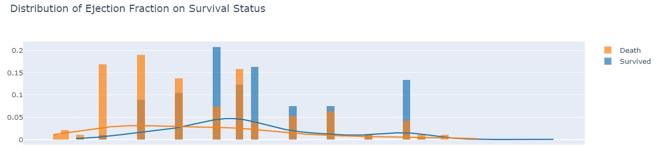
Notes:
Regarding ejection fraction, one of the traits in the group of patients who survived and lived after being diagnosed with heart failure was a high percentage of ejection fraction in blood. But those who passed away from cardiac failure had substantially lower blood levels of ejection fraction (Tripoliti, 2017).

Slide 13
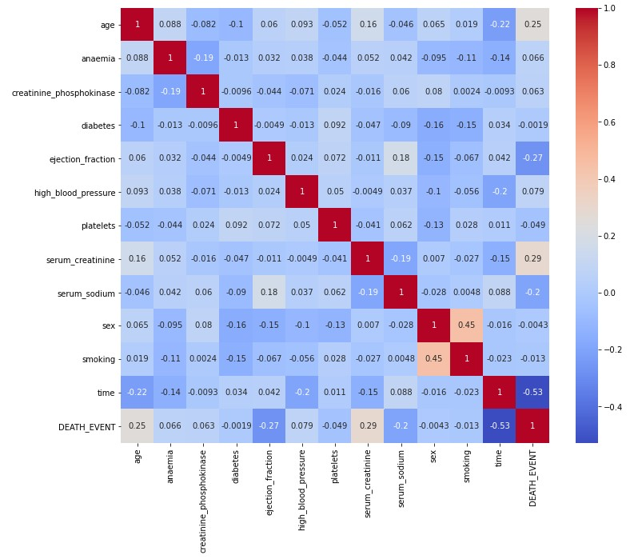
Phase 2
Notes:
Using a heatmap correlation, we did a feature selection process to determine which factors had the most impact on the death event variable depicted in Figure 10 after analysing the general correlations and patterns between various features.
Platelets and Creatinine Phosphokinase enzymes should be dropped from our model because, as shown in Figure 10, they do not appear to have the same impact on survival as other factors like smoking, sex, high blood pressure, diabetes, and anaemia. As a result, we should not choose these factors to base our model on.

Slide 14
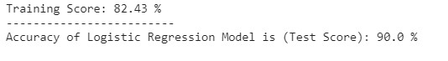
Phase 3 – Models Selection and Evaluation
Model 1: Logistic Regression
Notes:
Because it utilises a logistic function to plot a binary output model, logistic regression is more like a classification model than a regression model, while it shares certain similarities with linear regression
We were able to use logistic regression to achieve an accuracy score of 90% with a training score of about 82%.

Slide 15
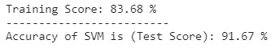
Model 2: Support Vector Machine
Notes:
The support vector machine is a tool that may be used for regression and classification.
The accuracy score for this prediction model using SVM was 91.67%, while the training score was 83.68%.

Slide 16
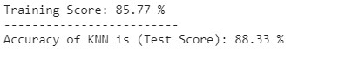
Model 3: K-Nearest Neighbors (KNN)
Notes:
A non-parametric model known as KNN is employed in both classification and regression. It is sometimes referred to as a model of lazy learning with local approximation (Tripoliti, 2017). When using KNN, we find k neighbours and make a forecast. We picked a k of 5 for the forecast since anything higher will cause our accuracy model to become less accurate
for KNN, the accuracy we obtained was 88.33% and the training score was 85.77%.

Slide 17
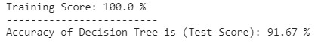
Model 4: Decision Tree
Notes:
Regression and classification issues are solved using decision trees. For dependent variables with continuous values, decision trees are employed, whereas classification trees are used for dependent variables with discrete values. The independent variables are used to create a decision tree, with each node having a condition over a feature. Based on the criteria, the nodes choose which node to travel to next. An output is anticipated once the leaf node is reached (Latha, 2019).
our training score was flawless and the decision tree prediction model's accuracy was 91.67%, which is quite intriguing

Slide 18
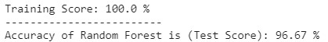
Model 5: Random Forest
Notes:
In an ensemble model called Random Forest, different decision trees are blended to create a more robust and precise model. With binary, categorical, and continuous characteristics, Random Forest develops a reliable, accurate model that can handle a wide range of input data (Latha, 2019).
Random Forest had a 96.67% accuracy score with a flawless training score on our dataset.

Slide 19
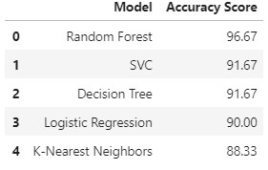
Table 1: Accuracy score summary table of all predictive models
Notes:
Table displays the overall summary of the accuracy scores obtained by the five models, ranking them from top to lowest in terms of accuracy scores.
shows the accuracy score comparison among all models in a bar plot

Slide 20
Discussion and Conclusion
Utilizing data analysis tools like histograms, heatmaps, and a data profiling stage facilitates the compilation of all EDA analysis. We found no missing values, indicating that the dataset was very clean and well-organized. In the second and third stages of our method, important characteristics were found using correlation heatmaps, and predictive models were created using these relevant and significant features. Out of the 13 variables, only 5 were ultimately determined to be significant and have a significant impact on our predictive model.
Notes:
Random Forest had the greatest accuracy score (96.67% for the prediction) out of the five models we created using training data from our dataset and testing. Out of all the models we examined, the KNN model had the worst accuracy (88.33%). If we can modify the hyperparameters using cross-validation on our dataset, there is greater possibility for advancement. Additionally, I think the n = 299 data sample may be a little too small. Our predictive model might be a lot more precise with a larger sample size, and we might even be able to comprehend and choose new features to include in our model. In general, depending on the provided health indicators, I think we can reliably forecast survival from heart failure disease using the Random Forest Model.

Slide 21
Thankyou

